Slide 1











PROJECT 2
LIFE EXPECTANCY

Slide 2








GROUP 4 MEMBERS
CHANG WEN XUEN (A23CS5012)
LIM CHEN XI (A23CS0103)
FOO MING KUANG (A23CS5026)
KAREN VOON XIU WEN (A23CS0229)

Slide 3

INTRODUCTION
The primary objective of this study is to identify and analyze the key determinants of life expectancy using a dataset from the World Health Organization (WHO) and supplementary economic data from the United Nations. By integrating various health, economic, social, and immunization-related factors, we aim to develop a predictive model that can help countries understand and improve their life expectancy rates. This comprehensive approach allows for a deeper insight into how different variables interact and contribute to life expectancy across diverse global contexts.

Slide 4
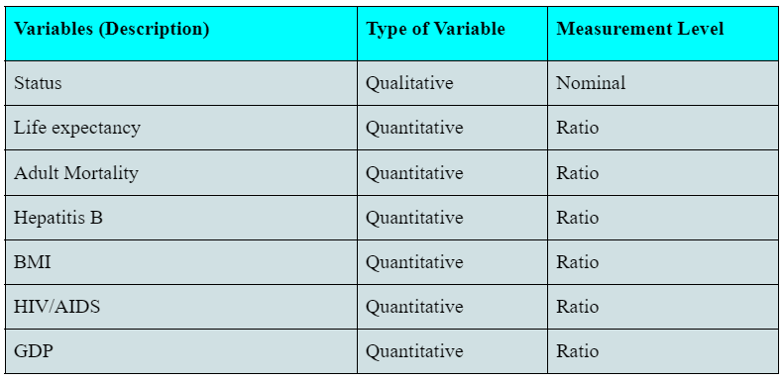
DATA DESCRIPTION

Slide 5
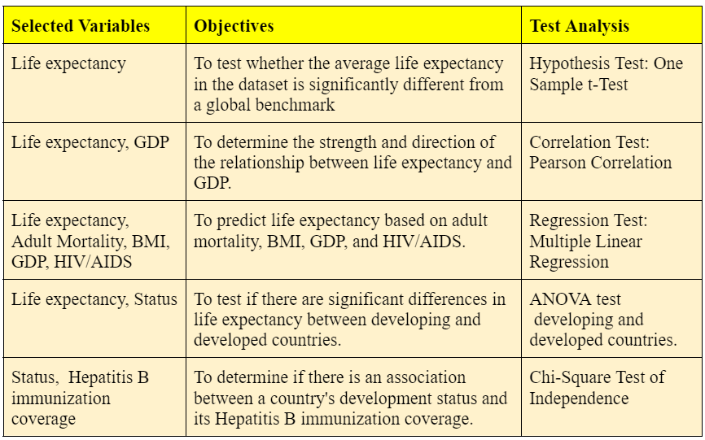
STATISTICAL TEST ANALYSIS

Slide 6
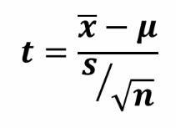
HYPOTHESIS TESTING:
ONE SAMPLE T-TEST
Hypothesis statement:
H₀: μ= 70
H₁: μ ≠ 70
To determine whether the average life expectancy in the dataset is significantly different from a global benchmark.
VARIANCE UNKNOWN, T-TEST FORMULA:
p-value= twice the area to the left of the test statistic

Slide 7
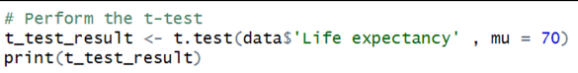
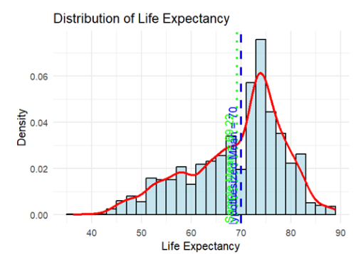
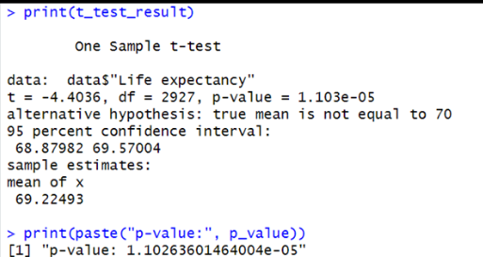
HYPOTHESIS TESTING:
ONE SAMPLE T-TEST
test statistic t= -4.4036,
p-value=1.1×10-5
sample mean=69.22

Slide 8
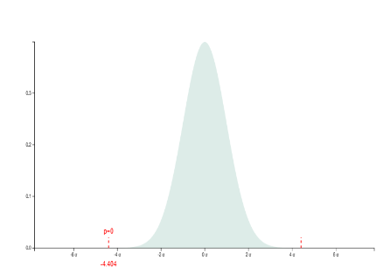
HYPOTHESIS TESTING:
ONE SAMPLE T-TEST
Since P-value 1.1×10^-5< 0.05, we reject the null hypothesis, there is sufficient evidence to conclude that the average life expectancy is significantly different from 70 years.
Distribution Graph when test statistic = -4.4036 and P-value=1.1×10^-5

Slide 9
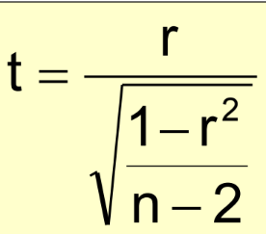
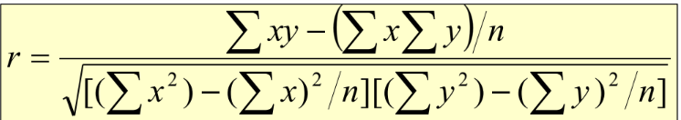
CORRELATION TEST
Hypothesis statement:
H₀: ρ = 0 (no linear correlation)
H₁: ρ ≠ 0 (linear correlation exists)
To determine the strength and direction of the relationship (linear relationship) between life expectancy and GDP
Pearson’s Product-Moment Correlation test formula:
Degree of freedom =n-2

Slide 10
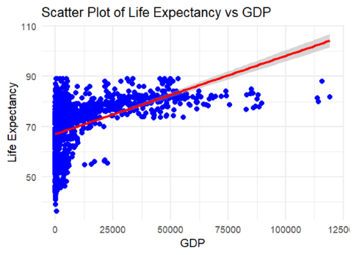
CORRELATION TEST
From the scatter plot , we can see that the points slope slightly upward, it indicates that there is a positive correlation between life expectancy and GDP, that is the higher the life expectancy, the higher the GDP.
By using RStudio, we also get a sample correlation coefficient, r = 0.461455, which indicates that there is a moderate positive linear correlation between life expectancy and GDP.

Slide 11
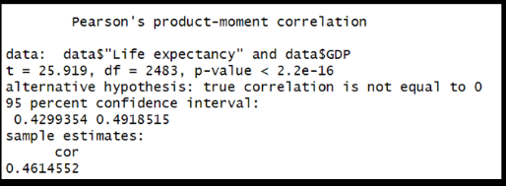
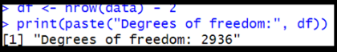
CORRELATION TEST
From R studio:
test statistic = 25.919
critical value = 1.9608
df = 2936
Conclusion:
Since the test statistic t=25.919 > upper tail critical value = 1.9608, we reject the null hypothesis. There is sufficient evidence to conclude that there is a linear relationship between life expectancy and GDP.

Slide 12


REGRESSION TEST
Regression Test - Multiple Linear Regression
To examine the relationship between life expectancy (dependent variable) and multiple predictors (independent variables: adult mortality, BMI, GDP, HIV/AIDS).
Life Expectancy = β 0 + β 1 (Adult Mortality) + β 2(BMI) + β 3(GDP) + β 4(HIV/AIDS) + ϵ
Dependent Variable: Life Expectancy
Independent Variables: Adult Mortality, BMI, GDP, HIV/AIDS

Slide 13
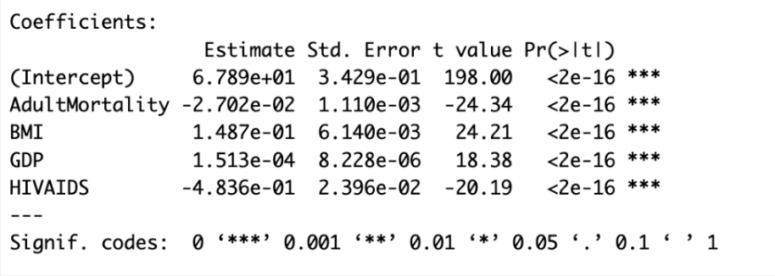
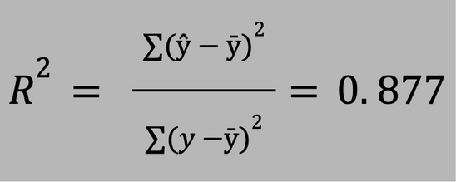

Intercept (β0): 67.89
Adult Mortality (β1​): -0.027
BMI (β2​): 0.15
GDP (β3​): 0.00015
HIV/AIDS (β4​): -4.84
ŷ = 67.89 - 0.027 (AdultMortality) + 0.15(BMI) + 0.00015(GDP) - 4.84(HIV AIDS)
GOODNESS-OF-FIT
COEFFICIENT OF DETERMINATION (R²)

Slide 14
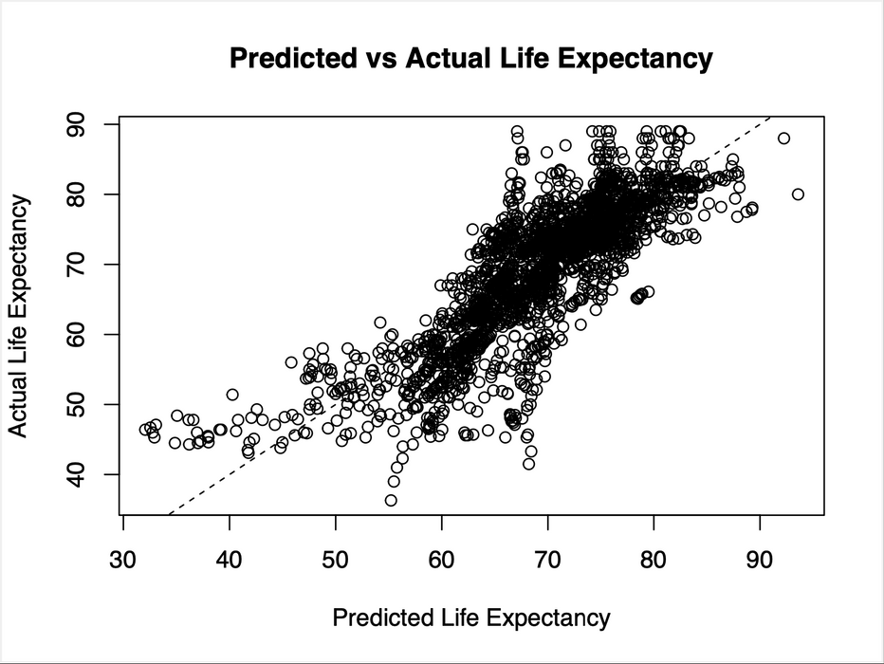

Key findings:
Higher adult mortality rates are associated with lower life expectancy.
Higher BMI and GDP are associated with higher life expectancy.
Higher HIV/AIDS prevalence is associated with significantly lower life expectancy.
strong linear relationship, indicating a good model fit.

Slide 15


ANOVA (ANALYSIS OF VARIANCE) TEST
To test if there are significant differences in life expectancy between developing and developed countries.
H₀: µDeveloped = µDeveloping
H₁: µDeveloped ≠µDeveloping
Status | n | 𝑥̅ | s
Developed | 2426 | 79.19785 | 3.930942
Developing | 512 | 67.11147 | 9.006092

Slide 16
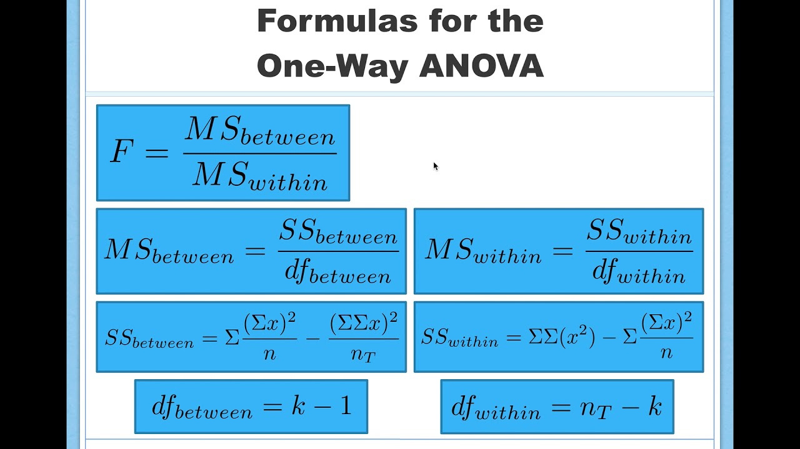
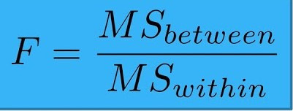
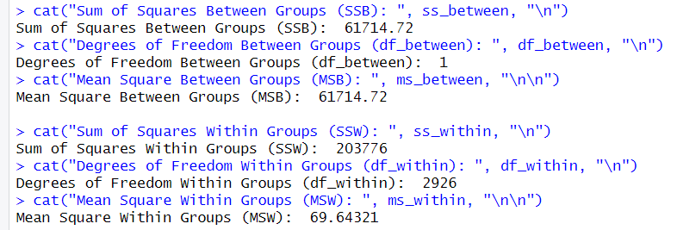
F-TEST STATISTIC FORMULA:
Results for MSB and MSW

Slide 17
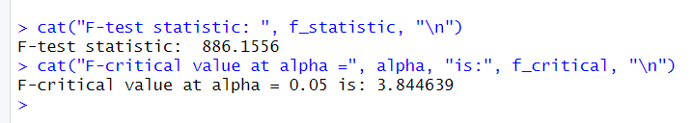
F-TEST STATISTIC FORMULA:
results for F-test statistic and F-critical value
F-test statistic > F-critical value (886.1556 > 3.844639),
we reject the null hypothesis, H₀, as there is sufficient evidence to claim that there is a significant difference in the means of life expectancy between Developed and Developing countries.

Slide 18
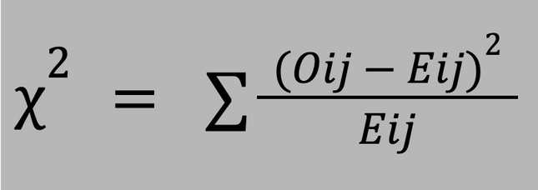
CHI-SQUARE TEST OF INDEPENDENCE
To determine if there is an association between a country's development status (developing/developed) and Hepatitis B immunization coverage (low, medium, high).
Low: Hepatitis B < 60
Medium: 60 ≤ Hepatitis B < 80
High: Hepatitis B ≥ 80
H₀: Hepatitis B immunization coverage is independent of a country's development status.
H₁: Hepatitis B immunization coverage is dependent on a country's development status.
Oij = Observed count at row i column j
Eij = Expected count at row i column j

Slide 19
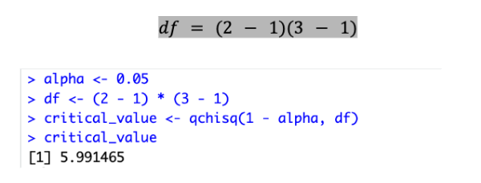
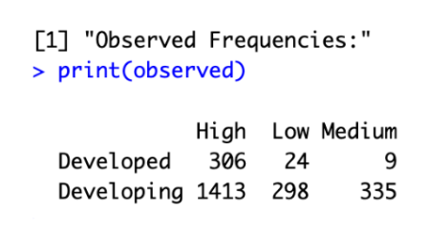
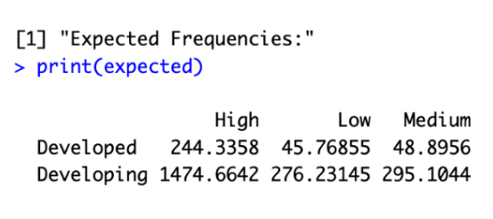
OBSERVED FREQUENCIES
EXPECTED FREQUENCIES

Slide 20

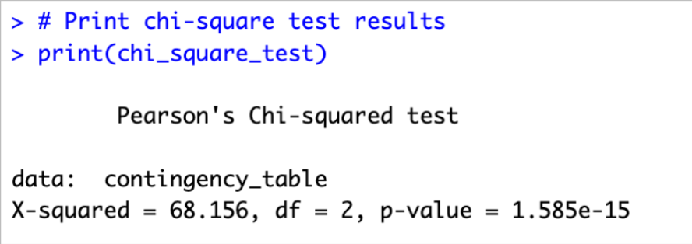

CALCULATING TEST STATISTICS
Since 𝜒² = 68.156 > 5.991, we reject the null hypothesis.
There is sufficient evidence to conclude that there is an association between a country's development status and its Hepatitis B immunization coverage.
Implications: Hepatitis B immunization coverage varies significantly between developing and developed countries.

Slide 21
THANK YOU VERY MUCH!

